Slide 1
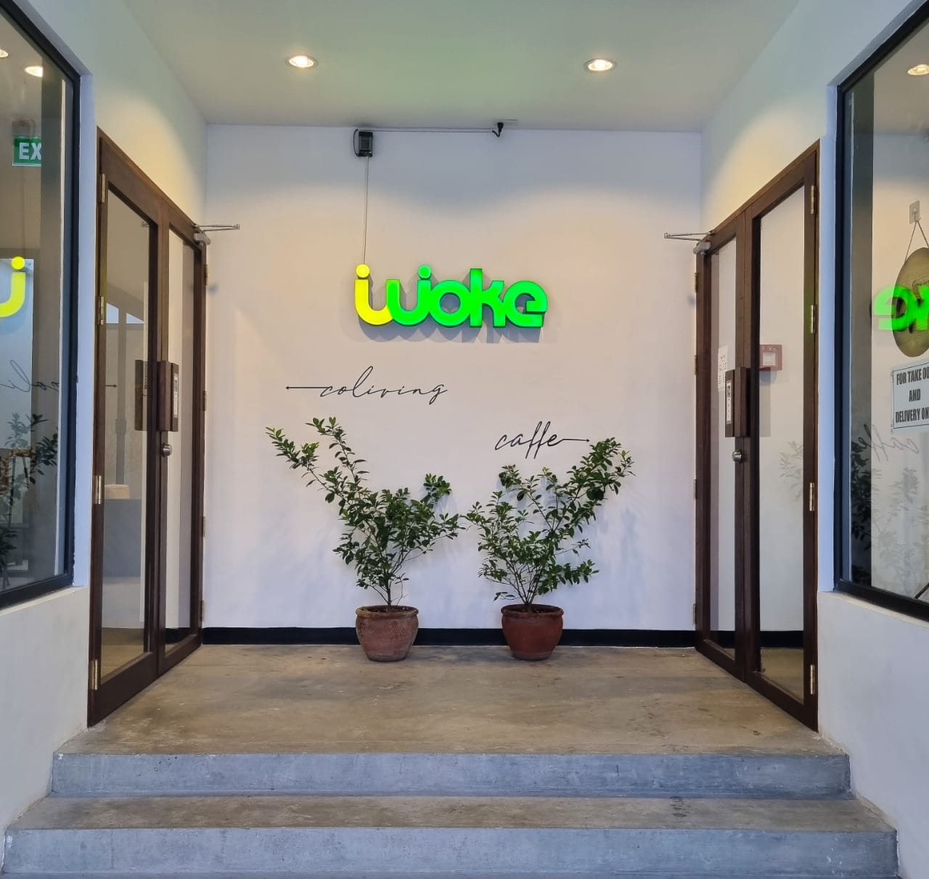
Woke Coliving Reservation And Management System

Slide 2
Introduction
To modernize its operations, Woke Coliving Inc. is replacing manual processes with an integrated digital strategy featuring a Dormitory Reservation Website and an automated Billing System. This dual-system approach aims to eliminate booking conflicts and payment delays, providing a scalable, data-driven foundation for more efficient management and a better tenant experience.

Slide 3

Background of the Study
Founded in 2021, Woke Coliving Inc. manages a 233-bed facility in Mandaluyong City but currently struggles with manual, error-prone booking and billing processes. To resolve frequent double-bookings and financial inconsistencies, the company is implementing the Woke Coliving Reservation and Management System. This digital transition will automate real-time inventory and payment tracking, ensuring operational accuracy and a better experience for urban tenants.

Slide 4
General Problem
Woke Coliving Inc. is addressing operational delays, data inaccuracies, and frequent booking conflicts caused by its outdated manual processes. To resolve these inefficiencies, the Woke Coliving Reservation and Management System was developed to automate core operations. By transitioning to this digital framework, the company ensures a seamless booking experience, accurate financial reporting, and reliable data management, providing a more professional and scalable service for its tenants.

Slide 5
Specific Problem
Woke Coliving’s reliance on manual tracking has created significant operational vulnerabilities, ranging from real-time inventory discrepancies and fragmented maintenance coordination to scheduling overlaps caused by varied stay durations. These inefficiencies often result in double-bookings and unready rooms, directly impacting revenue and the guest experience. Furthermore, the lack of a digital audit trail for key management and the absence of an automated financial ledger introduce security risks and billing inaccuracies. By digitizing these processes, the company can replace error-prone receipt compilation and verbal communication with a centralized system that ensures data integrity and operational security.

Slide 6
General Objective
This study focuses on developing and implementing the Woke Coliving Reservation and Management System, a digital solution designed to optimize occupancy rates and administrative efficiency. By automating the reservation workflow and centralizing resident data, the system provides a unified framework for operational oversight, ensuring data accuracy and a seamless experience for both management and tenants.

Slide 7
Specific Objective
The system is designed to streamline daily operations through a centralized dashboard that monitors real-time availability, maintenance statuses, and lease expirations. By synchronizing payment records with the reservation calendar, it aims to eliminate double-bookings and ensure 100% rental collection through real-time data accuracy. Additionally, the platform enhances security via a visitor management feature and improves financial transparency by providing residents with a secure portal for digital invoices. Ultimately, these integrated tools generate monthly occupancy and revenue analytics, empowering management to make data-driven decisions for strategic pricing and facility improvements.

Slide 8
Scope
The Woke Coliving Reservation and Management System is a centralized web-based platform that digitizes the entire coliving experience for both tenants and administrators. Tenants can easily view real-time room availability, sign digital rental agreements, and report maintenance issues directly through the portal. For administrators, the system provides a digital building map for floor-by-floor oversight, automates billing and contract renewals, and tracks security deposits. By integrating inventory management for essentials like pillows and beds with advanced revenue analytics, the system replaces manual tasks with a high-accuracy, data-driven framework for modern dormitory management.

Slide 9
Limitation
This system is exclusively designed for the Mandaluyong branch and does not support the Makati or Banahaw locations. As a web-only platform, it operates without integration into "smart" hardware such as electronic locks or automated utilities. While it supports GCash payments, the system prioritizes tenant security by not storing credit card or sensitive banking information. Additionally, the scope excludes administrative payroll and the tracking of general cleaning supplies, focusing specifically on core reservation and management functions.

Slide 10
Thank You

